Slide 1
CNN-Driven Brain Tumor Identification Using Medical Resonance Imaging
By
Marri Rohan(700741375)
Shanmukha Sai Nayudu(700757673)
Ram Gopal Lokam(700746228)
Mohammad Aslam Parvaz(700747364)

Slide 2
Roles and Responsibilities
Marri Rohan: Data collection and preprocessing
Collected Datasets from Kaggle
Preprocess the dataset for consistencyand resize the images forbetter results.
Shanmukha Sai Nayudu: Data Analysis and dataset splitting
Analyze the data and get the insights for dataset characterstics.
Trained and Tested the dataset models
Ram Gopal Lokam : Design and implementation of model
Design the model architectures and implementing the model using deep learning frameworks.
Mohammad Aslam Parvaz : Model evaluation and Conclusion
Evaluate the trained models using testing dataset and calculate performance metrics and provided perfect conclusion and future research

Slide 3
Motivation
The main motivation behind Brain tumor detection is to not only detect tumor but it can also classify types of tumor.
So it can be useful in cases such as we have to sure the tumor is positive or negative, it can detect tumor from image and return the result tumor is positive or not.
This project deals with such a system, which uses computer, based procedures to detect tumor blocks and classify the type of tumor using Convolution Neural Network Algorithm for MRI images of different patients.

Slide 4
Problem Statement
Developing an AI-assisted diagnostic tool for early detection and classification of brain tumors, aiming to enhance medical outcomes and streamline treatment protocols."

Slide 5
Objectives
Developing an algorithm that will yield a tumor picture extraction, enabling the medical team to determine the best course of action for treatment.
To provide doctors good software to identify tumor and their causes.
Provide a solution appropriately at early stages.
Early brain tumor detection using magnetic resonance imaging (MRI) may increase patient survival.

Slide 6
RELATED WORKS
Deep Learning-Based Techniques
Machine Learning-Based Techniques
Hybrid-Based Techniques

Slide 7
Image Analysis for MRI Based Brain Tumor Detection and Feature Extraction Using Biologically (6 March 2017):In this paper using MR images of the brain, we segmented brain tissues into normal tissues such as white matter, gray matter, cerebrospinal fluid (background), and tumor-infected tissues. We used pre-processing to improve the signal-to-noise ratio and to eliminate the effect of unwanted noise. We can used the skull stripping algorithm its based on threshold technique for improve the skull stripping performance.
A Survey on Brain Tumor Detection Using Image Processing Techniques(2017):This paper surveys the various techniques that are part of Medical Image Processing and are prominently used in discovering brain tumors from MRI Images. Based on that research this Paper was written listing the various techniques in use. A brief description of each technique is also provided. Also of All the various steps involved in the process of detecting Tumors, Segmentation is the most significant.
Review of Brain Tumor Detection from MRI Images(2016):In this paper, some of the recent research work done on the Brain tumor detection and segmentation is reviewed. Different Techniques used by various researchers to detect the brain Tumor from the MRI images are described. By this review we found that automation of brain tumor detection and Segmentation from the MRI images is one of the most active Research areas.

Slide 8
An efficient Brain Tumor Detection from MRI Images using Entropy Measures(2016) :: In this paper, we have investigated the different Entropy functions for tumor segmentation and its detection from various MRI images. The different threshold values are obtained depend on the particular definition of the entropy. The threshold values are dependent on the different entropy function which in turn affects the segmented results.
Identification of Brain Tumor using Image Processing Techniques(2019) :This paper survey of Identifying brain tumors through MRI images can be categorized into four different sections; pre-processing, image segmentation, Feature extraction and image classification

Slide 9
PROPOSED FRAMEWORK
Data Acquisition
Data Processing
Future Extraction
Model Development
Training and Validation
Integration and Development

Slide 10
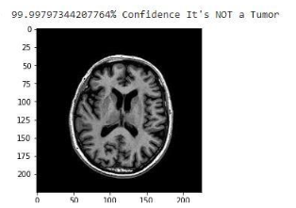
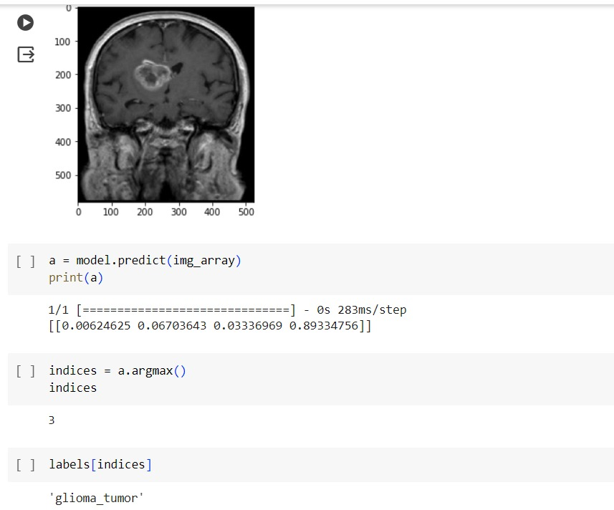
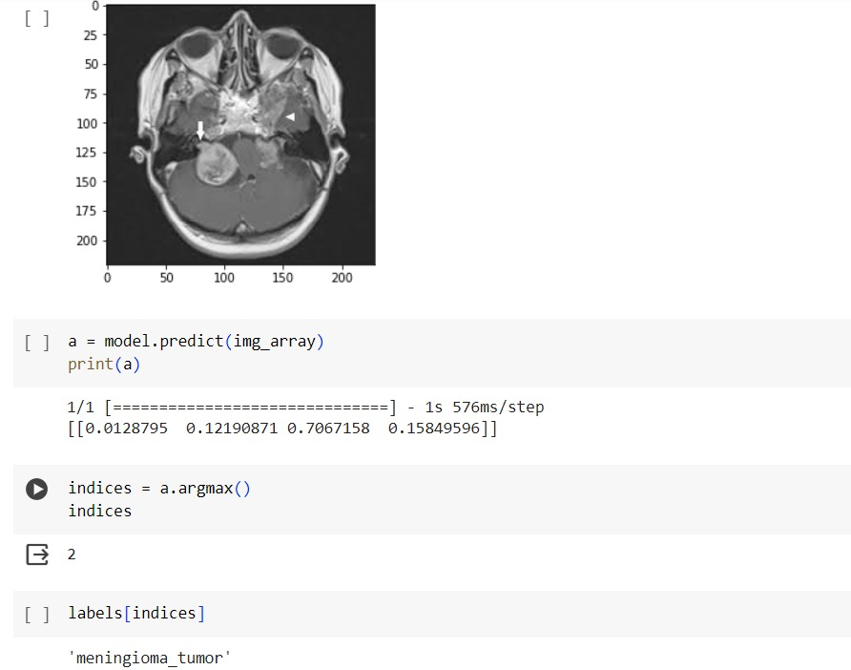
Results
Input Images: Output Images

Slide 11
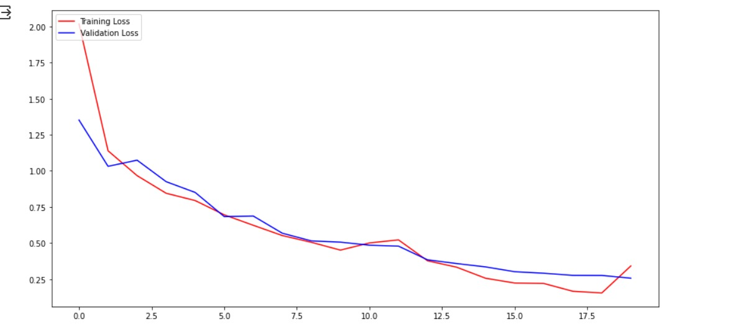
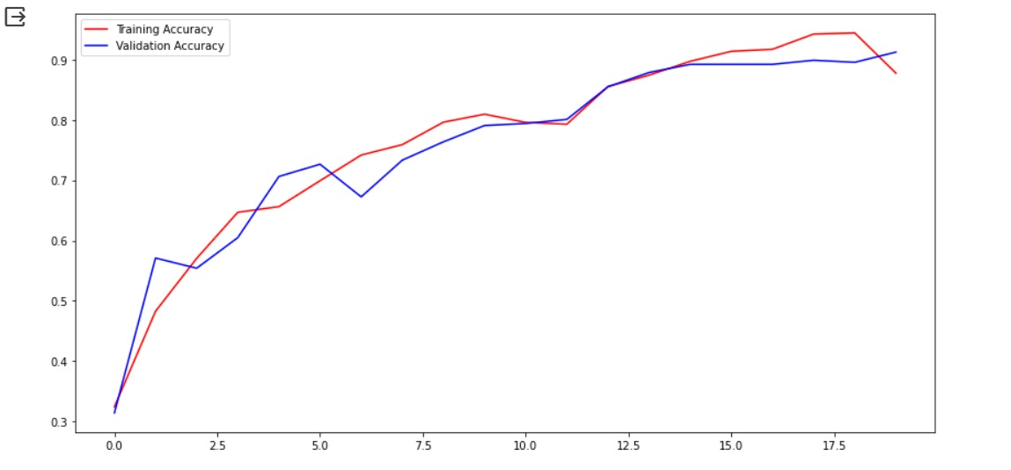
IMPLEMENTATION

Slide 12
Conclusion
he study presents two deep-learning models for detecting anomalies in the brain and grading several tumor types, including meningioma, glioma, and pituitary tumors. The "proposed 23-layer CNN" architecture is built to handle a relatively high quantity of image data, in contrast to the "Fine-tuned CNN with VGG16" architecture, which is built to handle a smaller amount of image data. The performance of the "Fine-tuned CNN with VGG16" model is also improved using a thorough data augmentation technique. Our experimental findings showed that both models improve the accuracy of brain tumor diagnosis prediction

Slide 13
References
1. Lee D.Y. Roles of TORsignaling in brain development. Exp. Neurobiol. 2015;24:177–185. doi: 10.5607/en.2015.24.3.177. [PMC free article] [PubMed] [CrossRef] [Google Scholar]
2. Zahoor M.M., Qureshi S.A., Bibi S., Khan S.H., Khan A., Ghafoor U., Bhutta M.R. A New Deep Hybrid Boosted and Ensemble Learning-Based Brain Tumor Analysis Using MRI. Sensors. 2022;22:2726. doi: 10.3390/s22072726. [PMC free article] [PubMed] [CrossRef] [Google Scholar]
3. Arabahmadi M., Farahbakhsh R., Rezazadeh J. Deep Learning for Smart healthcare—A Survey on Brain Tumor Detection from Medical Imaging. Sensors. 2022;22:1960. doi: 10.3390/s22051960. [PMC free article] [PubMed] [CrossRef] [Google Scholar]
4. Gore D.V., Deshpande V. Comparative study of various techniques using deep Learning for brain tumor detection; Proceedings of the 2020 IEEE International Conference for Emerging Technology (INCET); Belgaum, India. 5–7 June 2020; pp. 1–4. [Google Scholar]
5. Sapra P., Singh R., Khurana S. Brain tumor detection using neural network. Int. J. Sci. Mod. Eng. 2013;1:2319–6386. [Google Scholar]
6. Soomro T.A., Zheng L., Afifi A.J., Ali A., Soomro S., Yin M., Gao J. Image Segmentation for MR Brain Tumor Detection Using Machine Learning: A Review. IEEE Rev. Biomed. Eng. 2022;16:70–90. doi: 10.1109/RBME.2022.3185292. [PubMed] [CrossRef] [Google Scholar]
7. Yavuz B.B., Kanyilmaz G., Aktan M. Factors affecting survival in glioblastoma patients below and above 65 years of age: A retrospective observational study. Indian J. Cancer. 2021;58:210. [PubMed] [Google Scholar]
8. Fahmideh M.A., Scheurer M.E. Pediatric brain tumors: Descriptive epidemiology, risk factors, and future directions. Cancer Epidemiol. Prev. Biomark. 2021;30:813–821. doi: 10.1158/1055-9965.EPI-20-1443. [PubMed] [CrossRef] [Google Scholar]

